Slide 1


Trends and climate of US Breweries
A report prepared by Tajar, Inc.
Rajat Chandna, Andy Ho, An Nguyen, Jodi Pafford, and Tori Wheelis

Slide 2
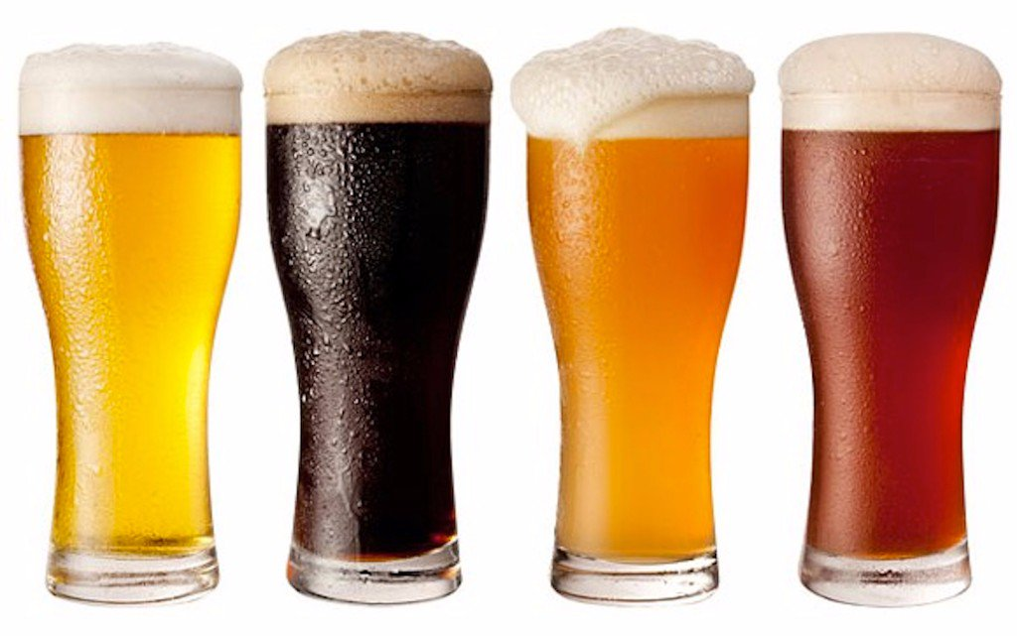
Agenda
Team Introduction
Process of Tidying the RAW data
Brewery
Beer
Summary and Analysis
Conclusion and QA
This Photo by Unknown Author is licensed under CC BY-NC-ND

Slide 3
The TAJAR, Inc Team:
Tori Wheelis
Andy Ho
Jodi Pafford
An Nguyen
Rajat Chandna

Slide 4
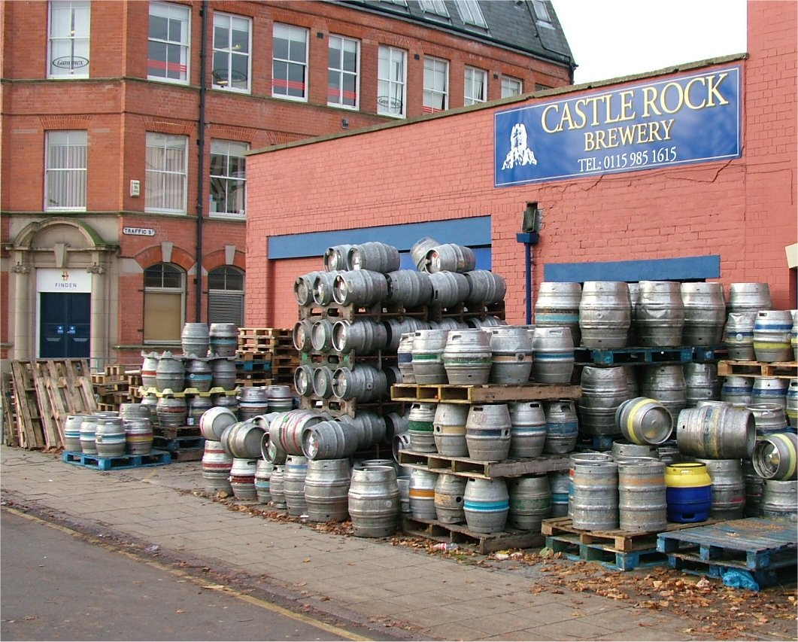
The Brewery File:
Original Has 558 Brewery Records
Importance of Data Integrity
Correcting records without sacrificing Data Set integrity
Double Sweep to Clean
Method of starting with State, City, Brewery Name & back to State
Nothing Falls through the Cracks
custom discovery loop to identify potential data issues
Correction Examples
St. Paul/St Paul → Saint Paul
Menominie/Menominee → Menomonie
Marquette, MA → Marquette, MI
Against The Grain → Against the Grain
Angry Minnow → Angry Minnow Brewing Company
Notes:
<ANDY>
At initial glance, the 558 records in the brewery file seemed to have a few duplicates. But one duplicate led to more discoveries and it became evident it required more than one data scientist’s eyes. Rajat and I were tasked to clean up the mess for the merge with the Beers file. Our strategy and approach is as follows:
Cleaning while keeping data integrity
Double Sweep to Clean any misspellings, punctuations, duplicates, and inaccuracies.
Creating a custom discovery loop so nothing fell through the crack.
To explain in more detail, Rajat will take us through the approach and results.
<RAJAT>
Thank you Andy. To echo what Andy said, our goal was to clean without removing any records with issues. We felt it was important to have all the brewery names, city, and state cleaned and prepped for the masterfile merge.
[Give explanation of the double sweep method and why we chose this approach]
[Give explanaiotn of the custom discovery loop written to capture the first 3/last 3 letters and why we were deliberate in creating this code]
[Provide a few examples of City correction and Brewery correction.

Slide 5
The Beers File:
Original file has 2,410 lines of data
Removal of obvious duplicates
Search beginning and ending strings
Kept beers with different ending strings (i.e. 2010, 2008)
Prepare File for Merging
Final File, CleanedBeerData, used to merge, contains 2,366 different types of beer
This Photo by Unknown Author is licensed under CC BY-NC-ND
Notes:
An: Thanks guys. Originally the beer file we obtained contained 2400 odd beers. The first thing we did was to remove all duplicates. To determine this we looked for entries that had matching Names, ABV, IBU, Brewer’s ID, Style, and size. This method removed approximately 30 entries. We also noticed that some beers had identical ABV, IBU, Brewer’s ID, Style and size but it’s name included a year of production. We assumed that this was a different formulation and left it as it’s own entry. After that we looked grouped the beers by size and then by brewery, we then looked for entries in each of these groups that had the first three characters or the last three characters matching. We then manually looked for beers that had the same variables but slightly different names.
Jodi: Thank you. Great description of the cleaning process, Andy, Rajat, and An. The final step in our process was preparing the files for merging. This was accomplished by changing the Brew ID column in the Brewery file to match the Beers file for an appropriate merge. The other columns that were renamed were the “name” column in both files to reflect Beer Name and Brewery Name. Upon final merge, the file contained 2,366 lines of beer data. Tori.

Slide 6
Organization and Structure of the masterfile
Summary:
2366 Unique Beers
382 Cities
50 States (plus 1 District)
Variables:
10 Variables
Notes:
<ANDY>
Thanks Tori. So after merging the brewery and beers into one master file, we find ourselves with 2,366 unique beers, spread throughout 382 cities, and 50 States (plus 1 District of Columbia) -- and 10 variables (aka description) for each of the beers. The variables are as follows:
Brewery_ID
Beer_ID
Beer_name
ABV – Alcohol by Volume – Standard measure of how much alcohol (ethanol) is contained in a given volume of an alcoholic beverage.
IBU – International Bitterness Units - Rather than telling us how much alcohol there is, IBU measures the bitterness from hops in a beer on a scale of 0 to 100
Style – Such as IPA, Pilsner, Lager, Pale Ale, etc…
Ounces – Standard capacity of the beer
Brewery_Name
City
State
We’ve taken the liberty of highlighting the first 6 and the last 6 records to verify the total count and variables. Please note the file is in ascending order by Brewery_ID.

Slide 7
Further Discoveries: Any missing Values?
STYLE: 5
ABV: 62
IBU: 997
Beer Name
Brewery Name
Ounces
City
State
Notes:
<ANDY>
There are some values missing but for the most part, limited to three variables:
Style
ABV
IBU
As you can see, Style has 5, ABV has 62,and IBU has 997. Only about 2.6% of the beers we have are missing information on alcohol by volume and 42% of the beers are missing information about their bitterness, using the International Bitterness Unit Scale. This will be taken into account as we answer other questions regarding ABV and IBU comparisons. Regardless, this still leaves majority of our beers with complete information. Most importantly, the Brewery and Beer Names, Ounces, City and State have no values missing.

Slide 8
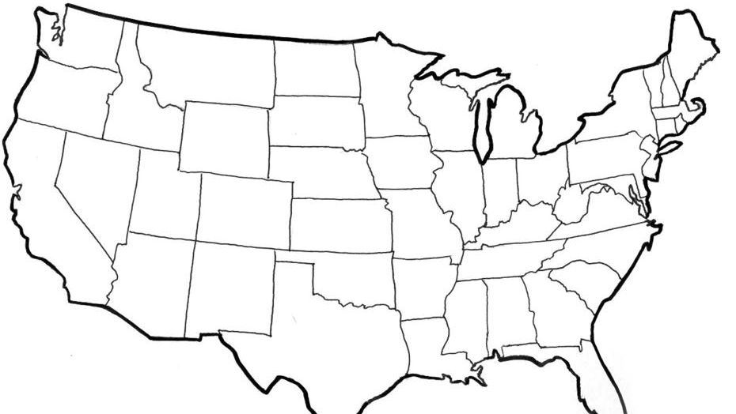
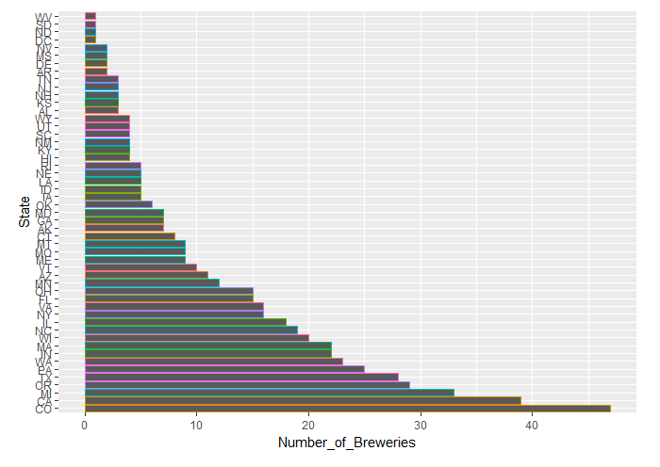
US Brewery Locations
This Photo by Unknown Author is licensed under CC BY-SA
Notes:
As we learned from Andy, all states (plus the District of Columbia) are represented in this dataset. Colorado had the most breweries at 47, which has a booming beer market. Other states with at least 25 breweries include California, Michigan, Oregon, Texas and Pennsylvania. Those 5 states range from 25 – 39. Over 50% of the states have less than 10 breweries represented in our dataset. Many of these are some of the smallest and/or lest populated states, but also include some larger states that are under represented in the market including: Arizona, Tennessee, New Mexico, Louisiana, Kansas, and Arkansas. Next, I’ll let Tori tell you about her discoveries of the beer contents. Tori.

Slide 9
US Brewery Locations
This Photo by Unknown Author is licensed under CC BY-SA
Notes:
As we learned from Andy, all states (plus the District of Columbia) are represented in this dataset. Colorado had the most breweries at 47, which has a booming beer market. Other states with at least 25 breweries include California, Michigan, Oregon, Texas and Pennsylvania. Those 5 states range from 25 – 39. Over 50% of the states have less than 10 breweries represented in our dataset. Many of these are some of the smallest and/or lest populated states, but also include some larger states that are under represented in the market including: Arizona, Tennessee, New Mexico, Louisiana, Kansas, and Arkansas. Next, I’ll let Tori tell you about her discoveries of the beer contents. Tori.

Slide 10
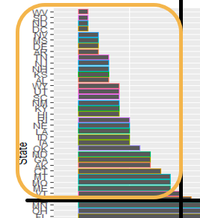
US Brewery Locations
This Photo by Unknown Author is licensed under CC BY-SA
Notes:
As we learned from Andy, all states (plus the District of Columbia) are represented in this dataset. Colorado had the most breweries at 47, which has a booming beer market. Other states with at least 25 breweries include California, Michigan, Oregon, Texas and Pennsylvania. Those 5 states range from 25 – 39. Over 50% of the states have less than 10 breweries represented in our dataset. Many of these are some of the smallest and/or lest populated states, but also include some larger states that are under represented in the market including: Arizona, Tennessee, New Mexico, Louisiana, Kansas, and Arkansas. Next, I’ll let Tori tell you about her discoveries of the beer contents. Tori.

Slide 11
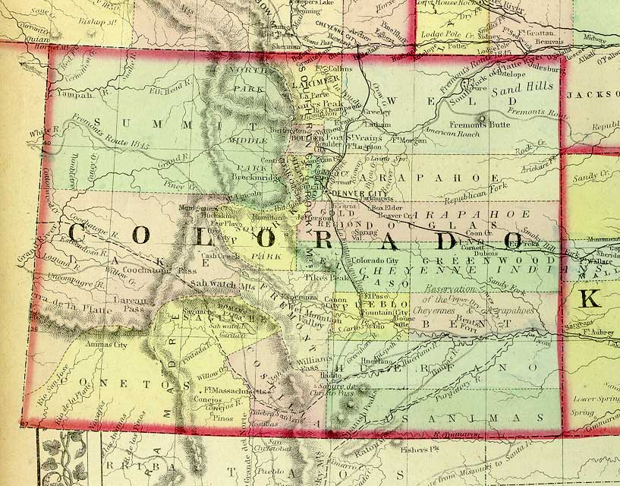
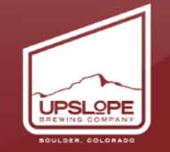
Maximum ABV BEER
12.8% ABV
This Photo by Unknown Author is licensed under CC BY-NC-SA
Notes:
The beer with the highest alcohol by volume is the Lee Hill Series Vol. 5 Belgian Style Quadruple Ale from Upslope Brewing Company in Boulder, Colorado, at 12.8%. This beer has a few close followers in ABV, an English Barleywine at 12.5%, a Russian Imperial Stout at 12.0 %, a Manhattan-Style Rya Ale (also from Upslope) at 10.4%, and a Baltic Porter at 10%.
The lowest alcohol by volume beer is the Scotty K NA from Uncommon Breweries, in Santa Cruz, California, and is billed as a low-alcohol beer.
You can see a list of the 20 top and bottom ABV beers in detail in our report, but I’ll touch on a few highlights.
It is interesting to note that 6 of the 20 lowest ABV beers are Ales (of varying types), with 4 Light Lagers and two Weissbiers, while in the top 20 of the highest ABV beers, there are 7 stouts (of varying types, mostly American Double/Imperial Stouts) and 3 Barleywines.

Slide 12
Rankings of Highest ABV per State
Bottom 6 Max ABV’s per State
Delaware- 5.5%
Arkansas- 6.1%
Tennessee- 6.2%
New Hampshire- 6.5%
North Dakota- 6.7%
West Virginia- 6.7%
Top 6 Max ABV’s Per State
Colorado- 12.8%
Kentucky- 12.5%
Indiana- 12.0%
New York- 10%
Wisconsin- 9.9%
Texas- 9.9%
Notes:
There are a few breweries and states that are represented multiple times in the maximum and minimum IBU and ABV top and bottom 20 lists. When each state's maximum alcohol-by-volume beer and most bitter beer are compared, we see slightly different results.
Here, we reported just the maximum ABV per state and reported the states with the lowest and highest maximum ABV’s. This allows us to get a picture of which states might have room in the market for a higher-alcohol beer.
As you can see, Arkansas and Tennessee are underlined. We will touch on this more in a moment.

Slide 13
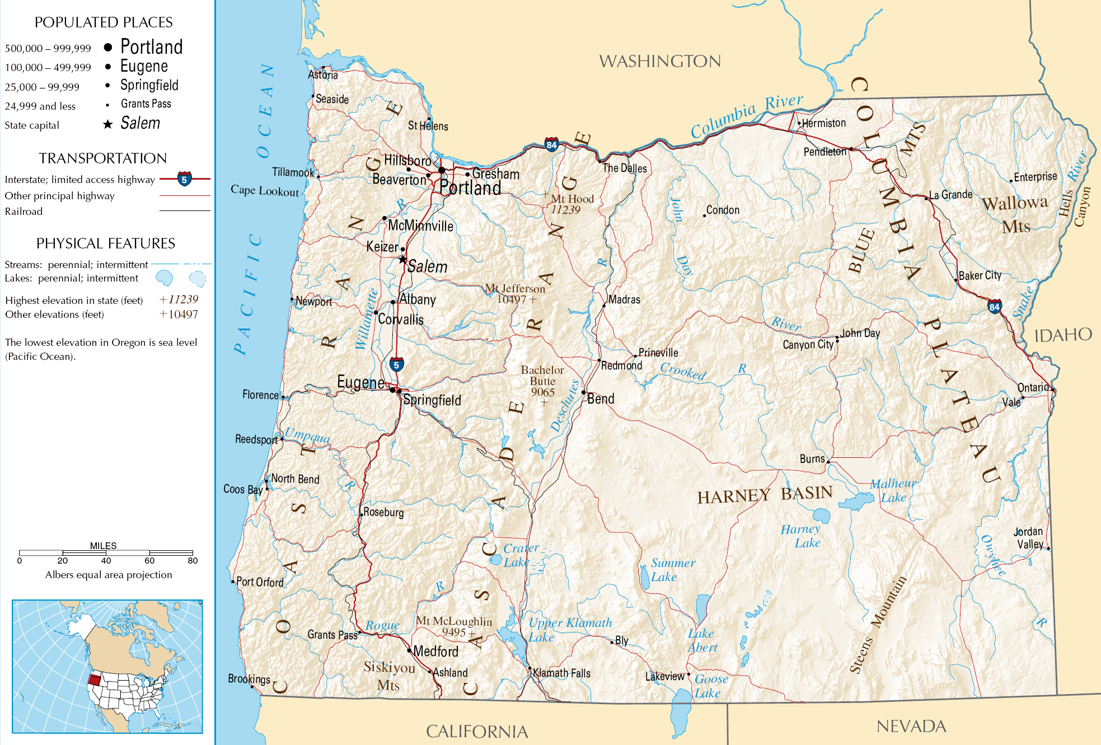
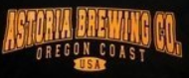
Most Bitter BEER (IBU)
138 IBU
This Photo by Unknown Author is licensed under CC BY-SA
Notes:
The beer with the highest International Bitterness Unit Score is also from Oregon, the Bitter Bitch Imperial IPA from the Astoria Brewing Company in Astoria, Oregon, with a score of 138. This beer also has a few close followers, including an American IPA at 135, an American Double IPA at 130, a Double IPA at 126, and an Imperial IPA at 120.
The beer with the lowest IBU score is actually a tie between three different versions of the same Cream Ale, entitlted “Summer Solstice” from Anderson Brewing Company in Boonville, California. These beers are followed by five beers tied in second place with an IBU score of five, a Berliner Weissbier, a Gose, a Tripel, a Fruit/Vegetable Beer, and another Gose, from San Antionio and Blanco, Texas, Fuquay-Variana, North Carolina, Davenport, Iowa, and Mount Pleasant, South Carolina, respectively.
If you’re curious to learn more, we did include a detailed list of the top and bottom 20 beers in our report.
It is important to note that only two of the top 20 most bitter beers in this dataset are not IPAs, while Wheat Ales, Goses, Weissbiers, and Cream Ales make up the majority of beers in the lowest 20 IBU list.

Slide 14
Rankings of Highest IBU per State
Bottom 6 Max IBU’s per State
Arkansas- 39
Delaware- 52
Louisiana- 60
Tennessee- 61
Georgia- 65
Nebraska- 65
Top 6 Max IBU’s Per State
Oregon- 138
Virginia- 135
Massachusetts- 130
Ohio- 126
Vermont- 120
Minnesota- 120
Notes:
There are a few breweries and states that are represented multiple times in the maximum and minimum IBU and ABV top and bottom 20 lists. When each state's maximum alcohol-by-volume beer and most bitter beer are compared, we see slightly different results.
Here, we reported just the maximum IBU per state and reported the states with the lowest and highest maximum ABV’s. This allows us to get a picture of which states might have room in the market for a higher-alcohol beer.
As you can see, Arkansas and Tennessee are again underlined; this is to highlight their presence in the bottom maximum ABV and IBU ratings per state. We are suggesting that these states might have markets with an open niche for a higher alcohol content, bitter beer, such as an IPA, which I know is a Brewing Bros specialty.

Slide 15
General ABV Statistics
Range of ABV’s varies widely
0.1% (California low-alcohol)
To a 12.8% (Colorado Belgian-style Quadruple)
Summary Statistics
Median ABV of entire dataset: 5.7%
Mean ABV: 6%
First Quartile: 5%
Third Quartile: 6.8%
Large proportion of beers between 5-7%
1363 beers in the dataset have an ABV between 4.9% and 7%
roughly 58% of the dataset
407 beers with ABVs over 7%
roughly 17% of the dataset.
This Photo by Unknown Author is licensed under CC BY-NC-ND
Notes:
There were a somewhat wide range of maximum beer ABV's in this dataset, from a .001 beer from California billed as a low-alcohol beer, to a much higher .128 Belgian-Style Quadruple beer from Colorado. The median ABV of the entire dataset is a .057 and the mean ABV is .06. The first and third quartiles, or the medians between the extremes and the mean, are .05 and .068 respectively, which means that a large portion of the beers in this dataset are between 5-6% alcohol by volume.
As you can see, a large proportion of the beers we studied have ABVs between 5-7%, while only 17% of the beers we studied have ABVs over 7%, thus demonstrating a potential need in the market.

Slide 16
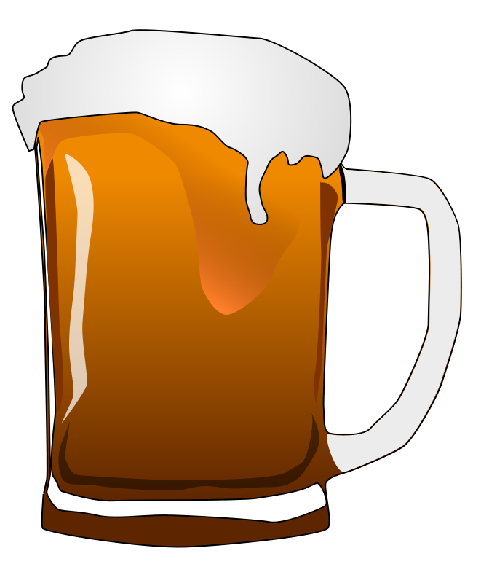
Median International Bitterness Units by State
Top 5 Highest Median IBU’s Per State:
Maine (61)
West Virginia (57.5)
Florida & Georgia (55)
Oregon (54)
Lowest 5 Median IBU’s Per State:
Wisconsin and Kansas (20)
Arizona (20.5)
Wyoming (21)
Hawaii (23)
Notes:
The state with the highest median IBU is Maine, with 61. Following Maine in the top 5 is West Virginia (57.5). Next, tied at 55, are Florida and Georgia, followed by Oregon (54).
The states with the lowest median IBU are Wisconsin and Kansas, tied at 20. Following Wisconsin and Kansas is Arizona (20.5), Wyoming (21), and Hawaii (23). You can see these in a list below.

Slide 17
Median Alcohol Content by State
Top 5 Highest Median ABV’s Per State:
Kentucky & Washington (.063)
West Virginia, New Mexico, & Michigan (.062
Lowest 5 Median ABV’s Per State:
Utah (.04)
New Jersey (.046)
Kansas, North Dakota, & Wyoming (.05)
Notes:
The states with the highest median ABV are Kentucky and Washington, D.C., with .063. Following Kentucky and DC in the top 5 median ABVs per state are West Virginia, New Mexico, and Michigan, all tied (.062).
The state with the lowest median ABV is Utah, with .04. Following Utah is New Jersey (.046), then Kansas, North Dakota, and Wyoming all tied with .05.

Slide 18
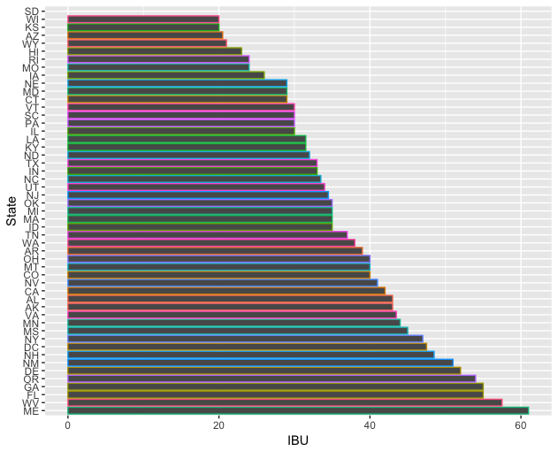
Median IBU’s per state

Slide 19
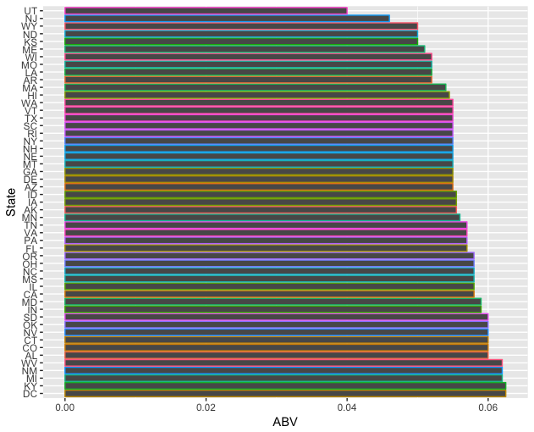
Median ABV’s per state

Slide 20
Median IBU and ABV’s per state

Slide 21
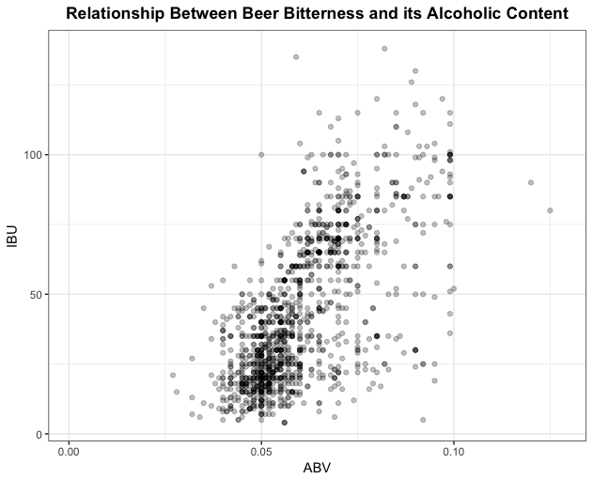
IBU vs ABV Relationship?
Notes:
While we had somewhat limited data on the IBU of the beers in our dataset, since it is not a required measurement for breweries to track for the purposes of quality control, we were able to construct a scatterplot to help us see if there is a relationship between the IBU and the ABV of a beer.
As you can see in the scatter plot below, it appears that there is a moderate correlation between the ABV and IBU of a beer between an ABV of .05-.10. You can see most of the beers are concentrated around ,05, or 5%, and very few go above .1, or 10%.

Slide 22

Conclusions
Tennessee
Arkansas
Kansas
Arizona
Prime Location
Between 6.5% and 7.5%
ABV
Between 50 and 60
IBU
Notes:
Jodi: As you can tell from this information, the US beer market is booming, and Brewing Bros will be able to find a great fit for location and brew in the United States. TAJAR, inc has a 3 part recommendation.
First is Location: Our recommendation is one of four states: Tennessee, Arkansas, Kansas or Arizona. These 4 states are some of the larger, more populous states with a small number of breweries.
Our second recommendation is ABV percentage. Our preliminary research has identified a gap in production of stronger ABV beers in some states. Tennessee and Arkansas, for example tap out with a max ABV at 6.2% and 6.1%, respectively. It is TAJAR’s recommendation that the beer brewed by Brewing Bros is between 7% +, allowing you to capitalize on this market in these states.
Finally, we would like to recommend an IBU target value. With the median IBU per state ranging from 20 to 61, there is some clear room for growth in some of our target states. The target range we recommend is 50-60 which could produce a fantastic high IBU Stout or low IBU Pale Ale. Either would be a fantastic choice.
Ultimately, Arkansas and Tennessee are the two states that TAJAR, inc has found with best potential. Their low property value and taxes, along with a seemingly untapped potential for these beer brews, it would make the perfect home for a Brewing Bros production of Stout or Pale Ale.

Slide 23
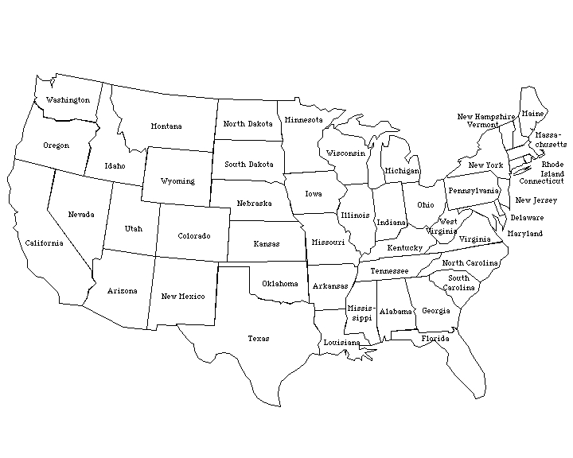
Notes:
Jodi: Ultimately, Arkansas and Tennessee are the two states that TAJAR, inc has found with best potential. Their low property value and taxes, along with a seemingly untapped potential for these beer brews, it would make the perfect home for a Brewing Bros production of Stout or Pale Ale.

Slide 24

Questions?
Notes:
Jodi: That was a lot of information! I suspect you will need to take some time to digest our full report. However, we would like to open the floor to you for any of your current questions…..

Slide 25
Thank You for allowing us to partner with you

